Slide 1







Reward Machines for Vision-Based Robotic Manipulation
Presented at ICRA 2021
contact: albercm@google.com
Alberto Camacho
Jacob Varley
Andy Zeng
Deepali Jain
Atil Iscen
Dmitry Kalashnikov
Robotics at Google
New York

Slide 2
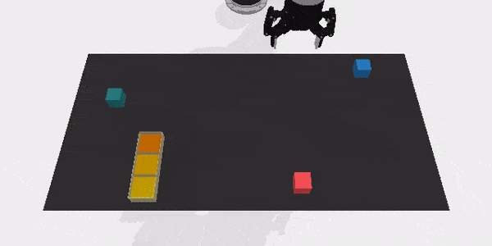
Take Home Message
...
We are concerned with… .. addressing some of the limitations of RL:
long-horizon tasks
large action spaces
large state spaces
To this end, we... ... apply principled methods for
task decomposition
reward shaping
… by augmenting DQN agents with reward machines (DQRM).
And we show that… ... DQRM greatly outperforms standard DQN in vision-based robotic manipulation tasks.
improved sample efficiency
better credit assignment

Slide 3
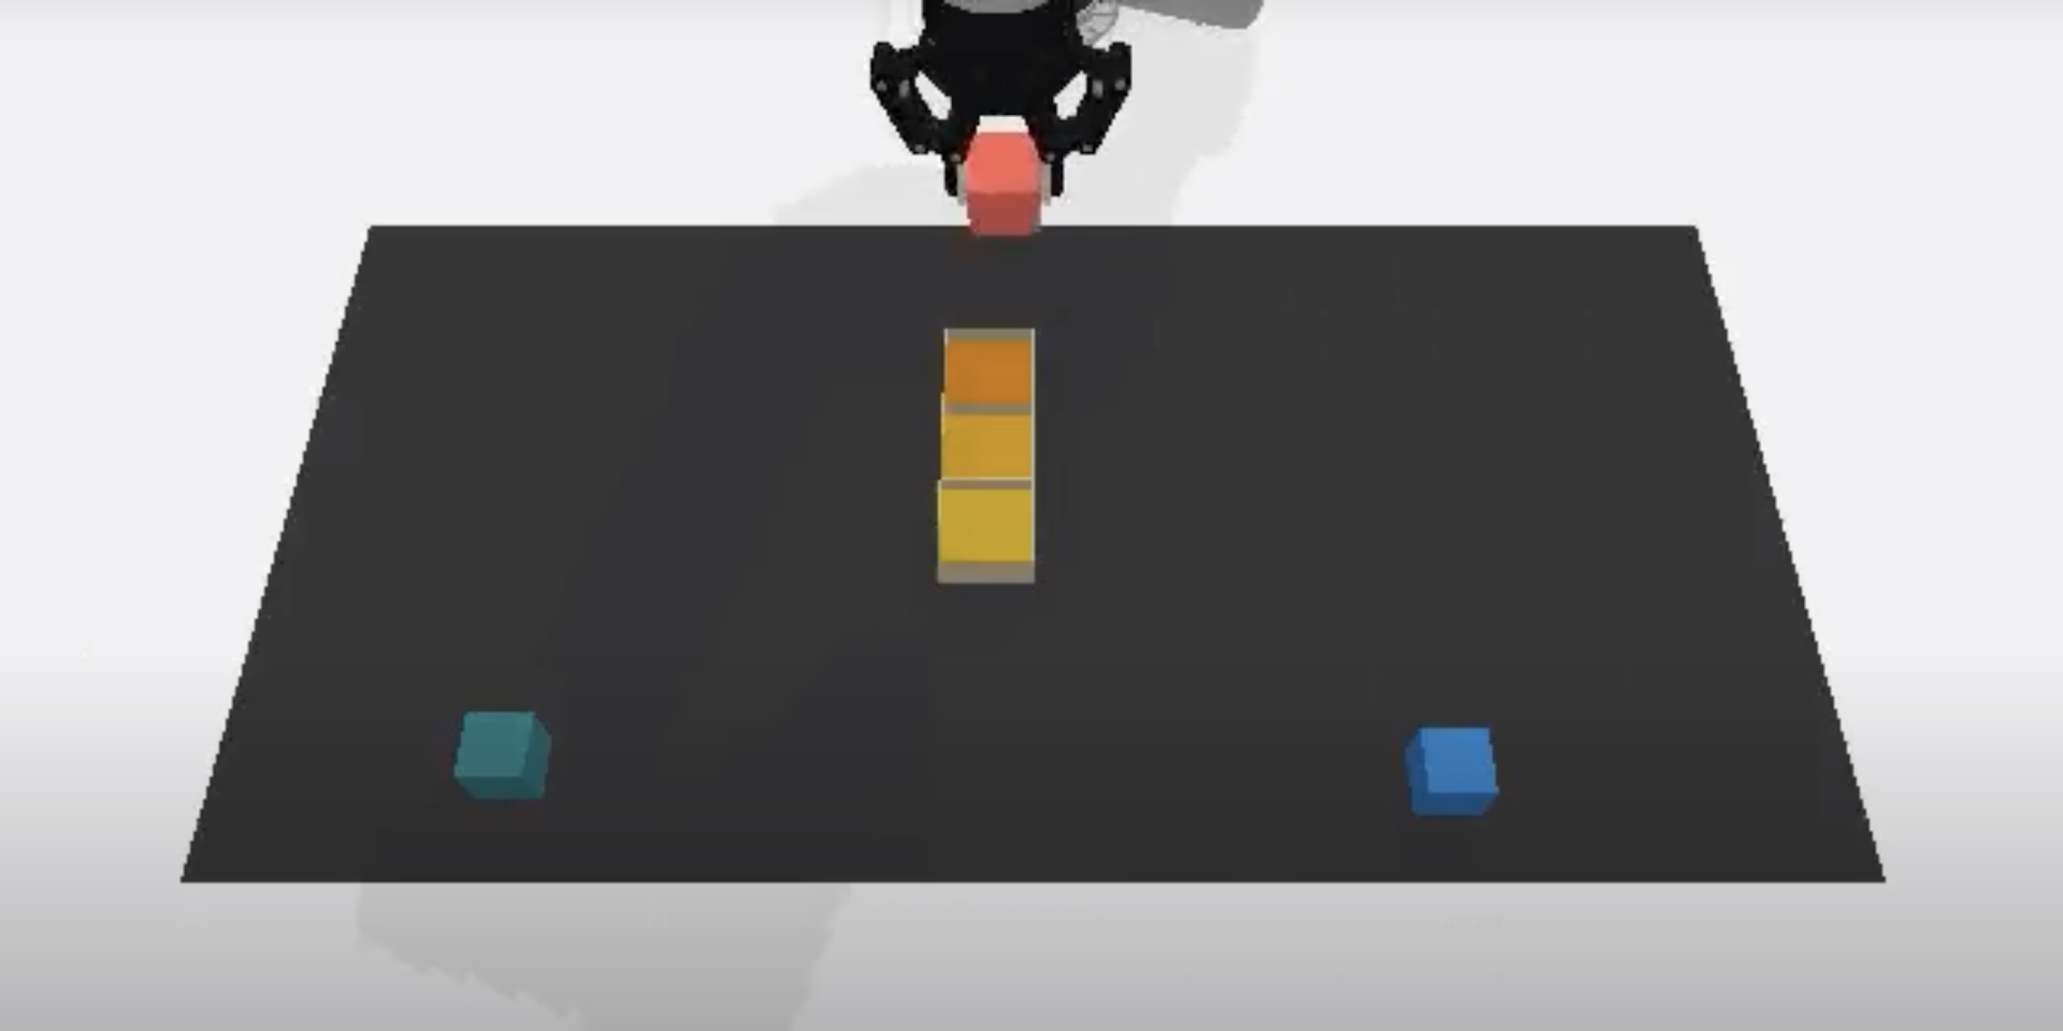



DQN With Reward Machines
action
This is a Reward Machine.
Represents an abstraction of the task as a graph.
Augments the RL loop with two supervision signals: 1) Abstract states 2) Dense rewards
Q value heatmaps
$
$
Abstract State ID
...
DQN
$
$
Top-down RGB
Observation
$
reward
Place Action
Pick Action
Standard RL loop
Notes:
Reward machines are graph structures that extend the standard RL training loop with two supervision signals: abstract states, and dense rewards.

Slide 4
DQN With Reward Machines
action
Abstract states are indicative of task progression.
Q value heatmaps
Abstract State ID
...
DQN
$
$
Top-down RGB
Observation
reward
Place Action
Pick Action
Standard RL loop
Notes:
Reward machines are graph structures that extend the standard RL training loop with two supervision signals: abstract states, and dense rewards.

Slide 5
DQN With Reward Machines
action
Dense rewards guide search.
Q value heatmaps
$
Abstract State ID
...
DQN
$
$
Top-down RGB
Observation
reward
Place Action
Pick Action
Standard RL loop
Notes:
Reward machines are graph structures that extend the standard RL training loop with two supervision signals: abstract states, and dense rewards.

Slide 6
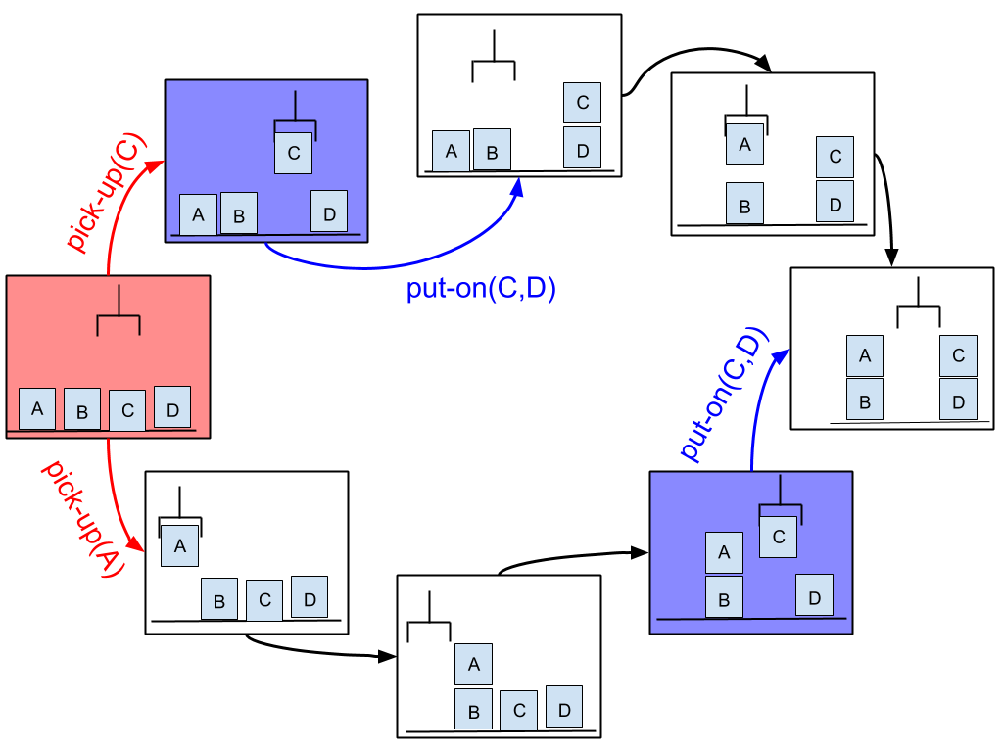
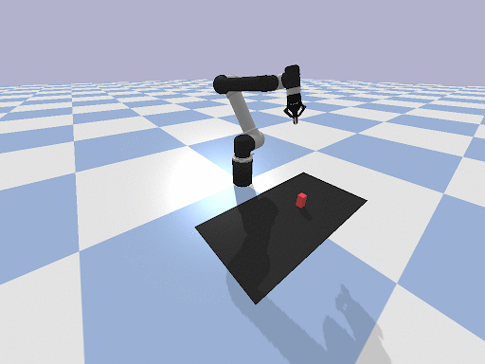
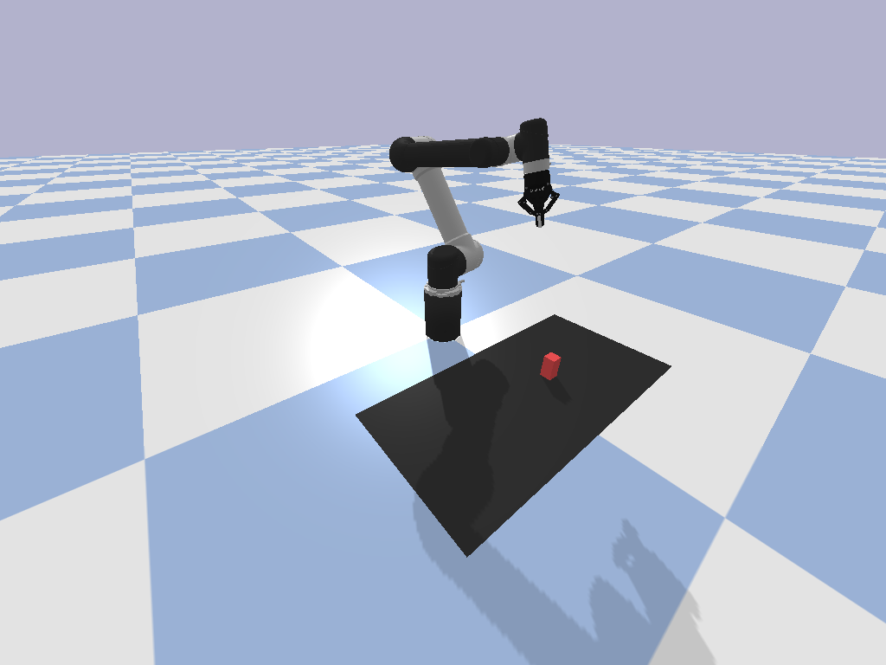
How do RL agents see Reward Machines?
Environment
Environment + Reward Machine
action
Observation
action
Observation
Agent
Agent
observation, reward
observation, reward
States are observations.
o = o’ =
Transition: (o, a, o’)
Environment reward: r(o, a, o’)
States are cross-product of observations and RM states.
s = ρ(s, a, s’) = 0.5 s’ =
Transition: (s, a, s’) Environment reward: r(o, a, o’) + ρ(s, a, s’)

Slide 7
How do RL agents see Reward Machines?
Environment
Environment + Reward Machine
action
Observation
action
Observation
= 0.5
$
Agent
Agent
observation, reward
observation, reward
States are observations.
o = o’ =
Transition: (o, a, o’)
Environment reward: r(o, a, o’)
States are cross-product of observations and RM states.
s = ρ(s, a, s’) = 0.5 s’ =
Transition: (s, a, s’) Environment reward: r(o, a, o’) + ρ(s, a, s’)

Slide 8
Reward Machines for Denser Rewards
Rewards in long-horizon tasks are very sparse:
=
+
+
+
Very sparse rewards:
0+0+...+0+0
0+0+...+0+0
0+0+...+0+0
0+0+...+0+1
Can we give a stronger supervision signal?
Denser rewards:
0+0+...+0+ .25
0+0+...+0+.25
0+0+...+0+.25
0+0+...+0+.25
More dense rewards:
0+...+.1+ …+.15
0+...+.1+ …+.15
0+...+.1+ …+.15
0+...+.1+ …+.15

Slide 9
Contributions
Methods to construct reward machines automatically from demonstrations, as opposed to having to construct them by hand or from a logical specification.
Evidenced the benefits of reward machines for RL in
vision-based robotics
with continuous actions
as opposed to prior work on domains with discrete state features and actions.
Proved that reward machines can improve sample efficiency and credit assignment.
More info on Reward Machines for RL: Using Reward Machines for High-Level Task Specification and Decomposition in Reinforcement Learning. R. Toro Icarte, T. Q. Klassen, R. Valenzano, and S. A. McIlraith. ICML 2018.
Notes:
Our contributions can be summarized in three points.
We provide principled methods to construct reward machines from demonstrations, as opposed to having to construct them by hand, of having to specify them.
We showed empirically the benefits of reward machines in vision-based robotics with continuous actions, as opposed to domains with discrete state features and discrete actions.
We showcase how reward machines are useful at disentangling planning and control.

Slide 10
Constructing Reward Machines from Demonstrations
Step 1:
Project demonstrations into abstract states using handcrafted feature detectors.
PROJECTION
Red block in hand
Red block on table
Red block in fixture spot #1
Red block in fixture spot #2
Red block in fixture spot #3
...
...
Abstract state Goal distance Potential
6 steps γ⁶
5 steps γ⁵
… … …
0 steps γ₀=1
Step 3:
Transition rewards are the difference of potentials.
$
Step 2:
Set potential values to each abstract state.
γ < 1
$
= γ Potential( ) - Potential( )
Notes:
We construct reward machines from demonstrations in three steps.
We project each demonstration into a stream of abstract states. Abstract states are obtained by projecting environment observations into a set of handcrafted state features that detect meaningful properties, such as whether the gripper is holding a block.
We associate potential values to teach abstract states. Those values are 1 in goal states, and vanish exponentially with their distance to the goal.
We define the rewards that the reward machine gives to state transitions. Those rewards are simply the difference of potential values between the next and current states. The idea is that transition rewards are positive when the agent makes progress in the task, and negative otherwise.

Slide 11
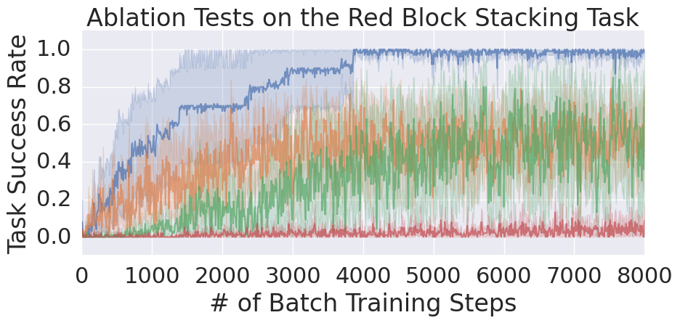
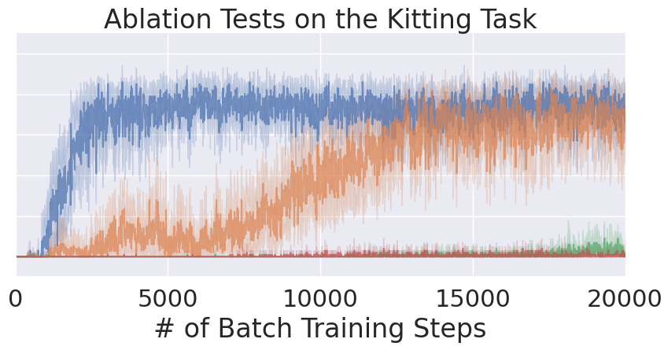
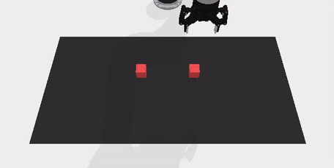
Experimental Results
DQN with reward machines learns:
better-quality policies
with fewer training steps,
compared with other ablations.
DQN with Reward Machines outperforms the sole use of abstract states and reward shaping
DQN with reward machines
better
DQN with reward shaping
DQN augmented with abstract states
Standard DQN
Notes:
In our experiments, we evaluated the benefits of reward machines in vision-based robotic manipulation tasks.
We see that the performance of standard DQN can be improved by ugmenting their observations with abstract states (green)
Alternatively, the performance of standard DQN can be also improved by providing dense rewards via reward shaping (orange)
DQN with reward machines (blue) combines abstract states and dense rewards, and their performance is the best of all configurations.
Reward machines can guide the agent (via rewards) and inform about task progression (via abstract states)
Finally, in a simple stacking task we show that reward machines can help diseentangle planning and control, and we see it clearly by inspecting the Q value heatmaps of the action pick and place. They are diambiguated when using reward machines, whereas they look very similar whithout eward machines.
If you want to learn more, visit go/task_decomposition and reach out if you want to collaborate.
Thanks for listening

Slide 12
Let’s understand it better!
We will take a closer look at the Q values of:
DQN with reward machines, and
DQN with reward shaping

Slide 13

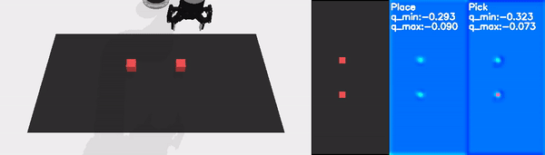
An Intriguing Phenomenon
In a 2 blocks stacking task:
DQN with reward shaping does not learn to condition actions (pick vs. place) on the number of blocks.
DQN with reward shaping has a high probability of choosing the wrong action (place) when there are two blocks on the table.
The Q value heatmaps for DQN with reward machines separate pick and place actions.
Training with DQN with reward machines
Training with DQN with reward shaping

Slide 14
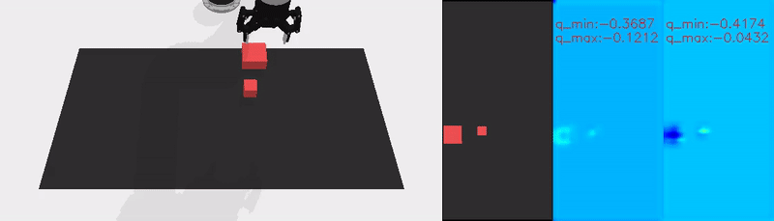
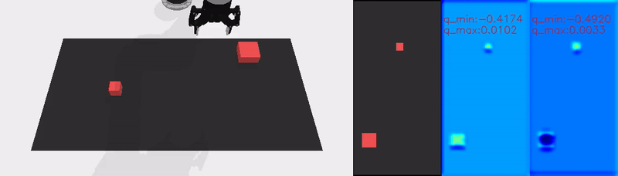
An Intriguing Phenomenon (cont.)
In a 2 blocks stacking task with blocks of different sizes:
DQN with reward shaping does not learn to condition actions (pick vs. place) on the number/size of blocks.
The Q value heatmaps for DQN with reward machines separate pick and place actions.
Training with DQN with reward machines
Training with DQN with reward shaping

Slide 15
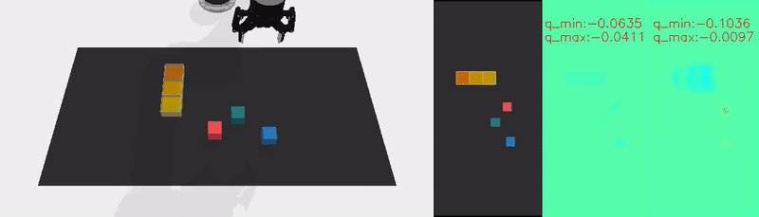
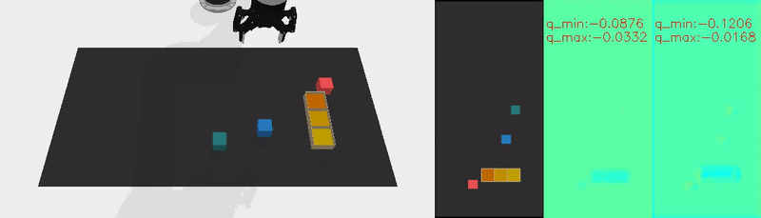
An Intriguing Phenomenon (cont.)
In a 3 blocks kitting taks:
DQN with reward shaping fails at recognizing the target locations of the blocks.
The pick and place Q value heatmaps for DQN with reward shaping are flat and look very similar to each other.
The Q value heatmaps for DQN with reward machines separate pick and place actions.
Training with DQN with reward machines
Training with DQN with reward shaping
Place
Pick
Place
Pick

Slide 16
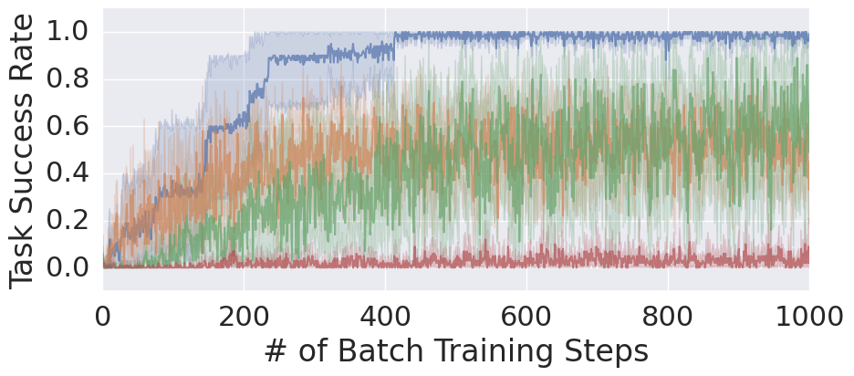





Summary and Final Remarks
DQN augmented with Reward Machines
Standard RL loop
Reward machine has:
1) Graph structure
2) Dense rewards
action
$
$
Q value heatmaps
Abstract State ID
...
DQN
$
DQN with reward machines
$
Top-down RGB
Observation
reward
Place Action
Pick Action
better
DQN with reward shaping
$
DQN augmented with abstract states
Standard DQN
DQN with Reward Machines
DQN without Reward Machines
Without the supervision of abstract states, DQN had a high probability of not choosing pick actions appropriately, resulting in grasp failures.
Q value heatmaps look different
Q value heatmaps look similar
Reward machines can:
guide the agent, via dense rewards (reward shaping)
inform about task progression, via abstract states
Reward machines can be useful to RL agents in vision-based robotics.
better credit assignment
more sample efficiency
versus
Place Action
Pick Action
Place Action
Pick Action
Robotics at Google
New York

